Slide 1
VitalMonitor
IoT-Driven Healthcare Management and Monitoring System
Vivek Choradia
Revolutionizing healthcare support with modern technology for healthcare professionals.
1/5

Slide 2
Real-Time Support
High Level of Stress in Healthcare
VitalMonitor
Centralized Design
Remote and Non-Intrusive Device
2/5
Notes:
Healthcare professionals face significant stress and fatigue, a concern highlighted by entities like the Care Quality Commission and the British Medical Association. Traditional support methods like questionnaires or daily checkups are no longer sufficient. Organizations need real-time, non-intrusive, centralized monitoring solutions, which led to the development of VitalMonitor.

Slide 3
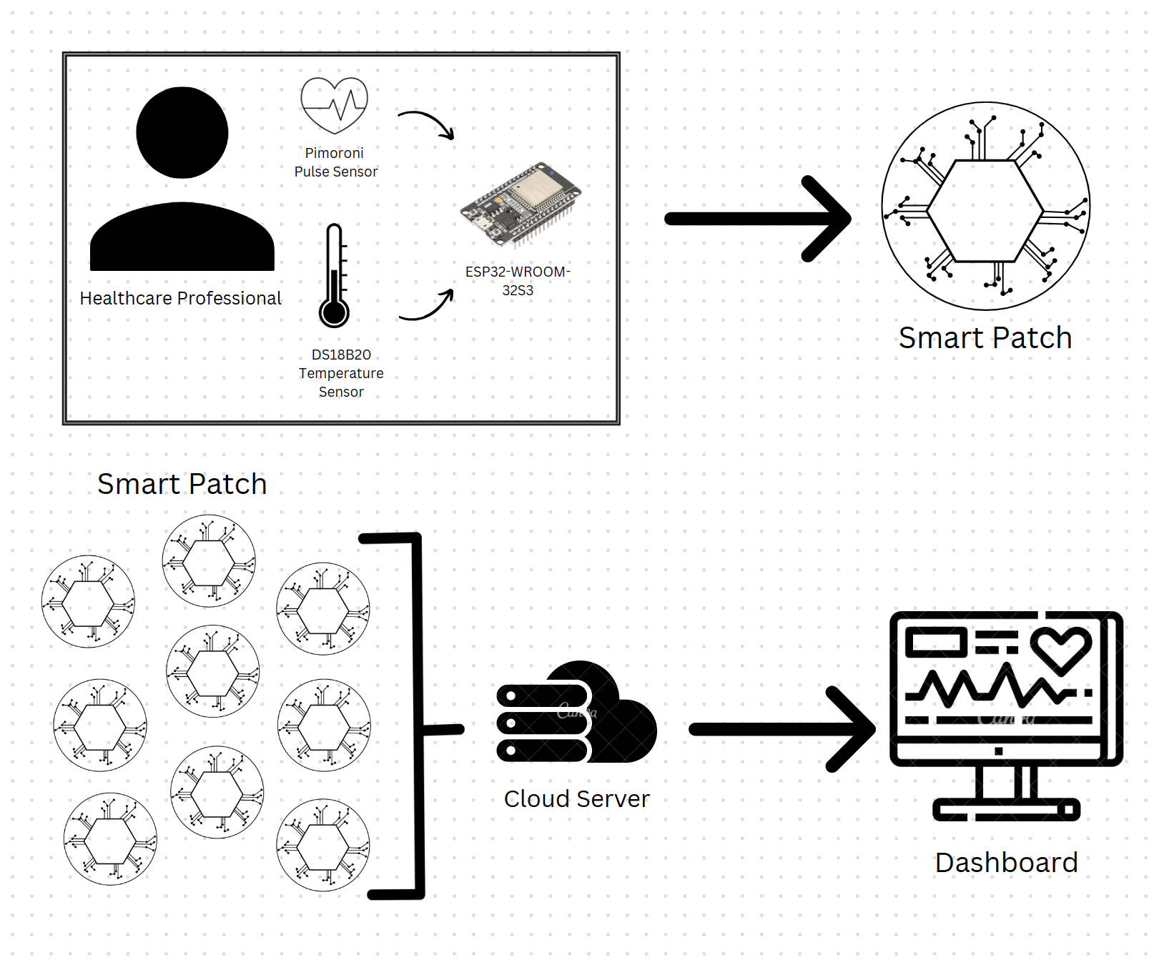
Solution : Smart Patch
3/5
Notes:
VitalMonitor addresses these challenges with two key components: the Smart Patch and a centralized dashboard. The Smart Patch is a wearable IoT device that tracks heart rate and body temperature discreetly. Data is transmitted in real-time to a cloud-based dashboard accessible by healthcare administrators, enabling immediate response to any arising needs.

Slide 4

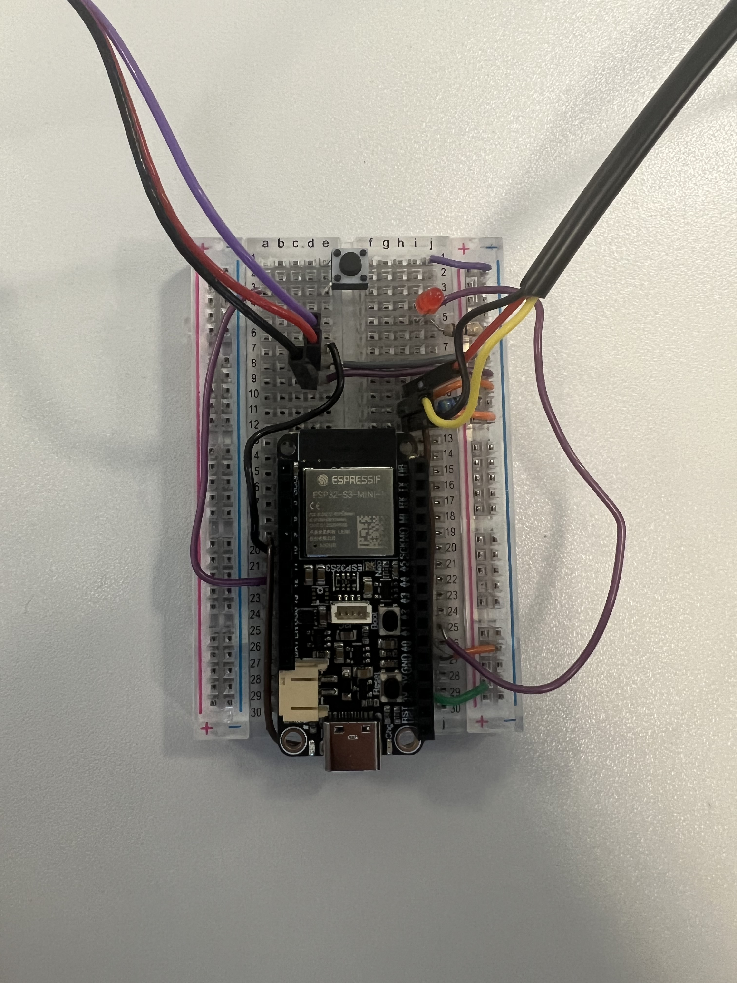
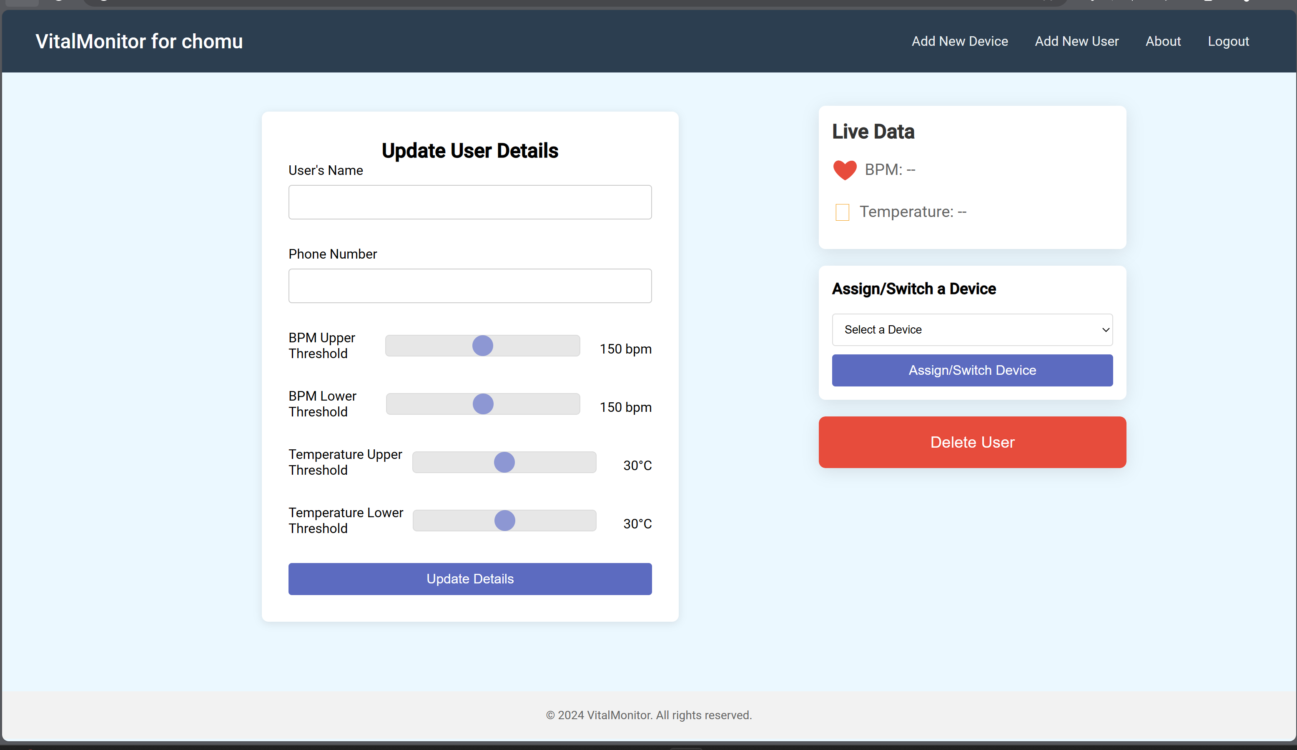
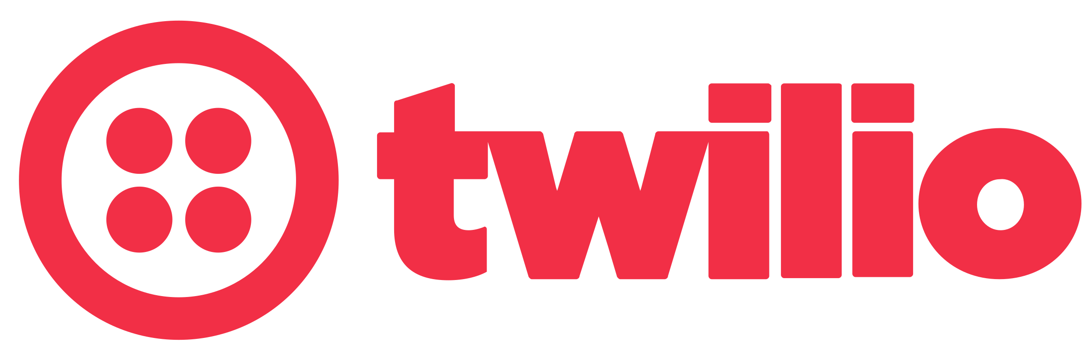
Implementation: Overview
VitalMonitor
VitalMonitor
User using Smart Patch
Admin using Dashboard
Middleware
Session Management Service
User & Device Management Service
Data Ingestion Service
Data Retrieval Service
4/5

Slide 5
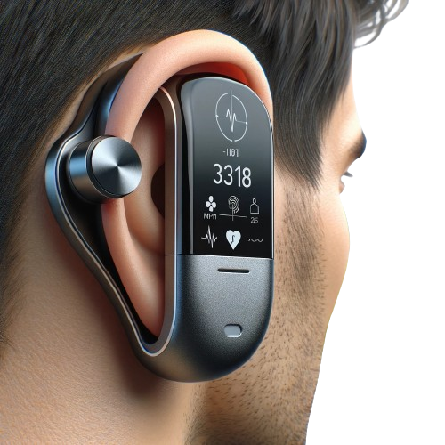

Limitations & Future Work
VitalMonitor
User using Smart Patch
Admin using Dashboard
Middleware
Session Management Service
User & Device Management Service
Trade off between Sensor Accuracy and Non-Intrusiveness
Data Ingestion Service
Data Retrieval Service
Load Balancer
Generated using Dall-E
5/5
Notes:
Looking ahead, I plan to evolve the prototype into a fully functional device, decompose the middleware into isolated microservices, and introduce a load balancer to manage the network load more effectively. These improvements aim to enhance scalability and reliability across multiple devices and users.

